Slide 1


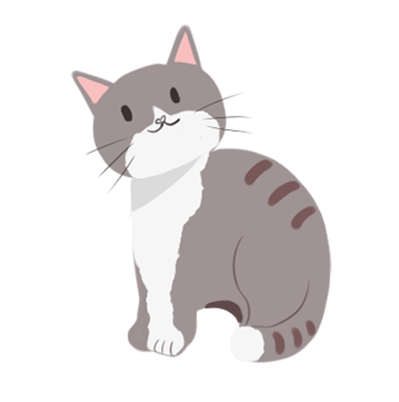

清明节
the Tomb-Sweeping Day

Slide 2
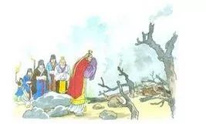
清明节英文介绍
Qingming Festival, or the Tomb-Sweeping Day is one of the Chinese Twenty-four Solar Terms. It is on April 4th or 5th of the Gregorian calendar. It is the crucial time for plowing and sowing in the spring. From that date, the temperatures begin to rise and rainfall increases.

Slide 3

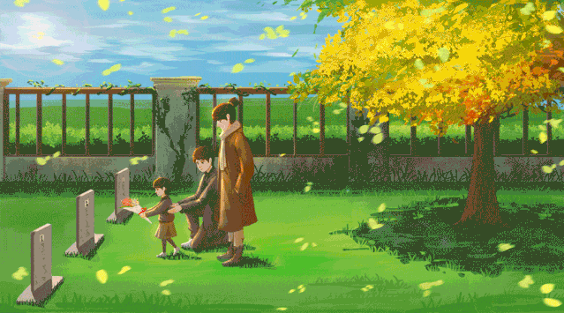
Tomb Sweeping 扫墓

Slide 4
Tomb Sweeping 扫墓
Cleaning the tombs and paying respect to the dead with offerings are the two important practices to remember late relatives. Weeds around the tomb are cleared away and fresh soil is added to show care for the dead. The dead person's favorite food, wine and chopsticks are offered on their tombs, along with paper money.

Slide 5

Spring Outing踏青

Slide 6
Spring Outing踏青
As trees turn green, flowers blossom, and the sun shines brightly, everything returns to life. It is a fine time to appreciate the beauty of nature. This custom can be traced back to the Spring and Autumn Period (770 – 476BC) and Warring States Period (475 – 221BC).

Slide 7
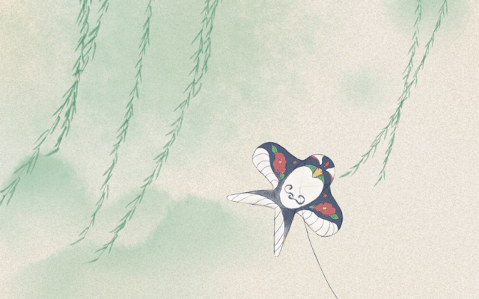
Flying Kites 放风筝

Slide 8
Flying Kites 放风筝
Flying kites is also closely associated with the Qingming Festival.
放风筝也是和清明节密切联系的一项活动。
Spring outings not only add joy to life but also promote a healthy mind and body.
清明节外出踏青等活动不仅给生活增添了欢乐，也促进了身心的健康。

Slide 9
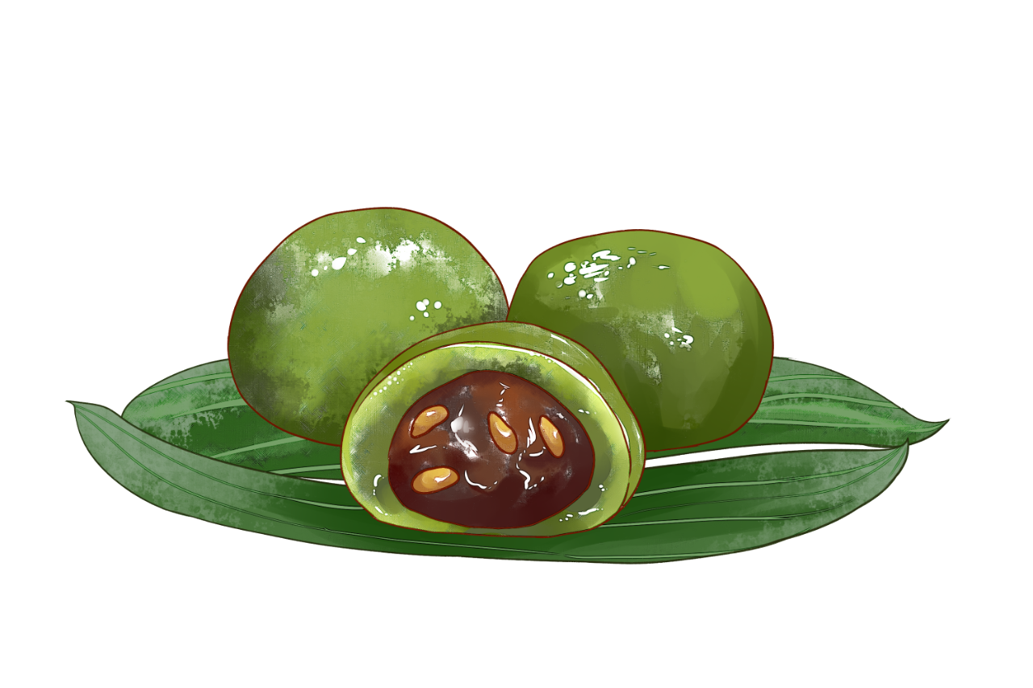
Green rice ball 青团

Slide 10
Green rice ball 青团
People in the Jiangnan region often eat this kind of green colored balls made from glutinous rice on Tomb Sweeping Day. The green color is from the juice of brome grass that is added in the rice.
江南地区的人们经常在清明节食用这种由糯米制成的绿色团子。由于糯米中混合雀麦草汁，所以团子呈绿色。

Slide 11
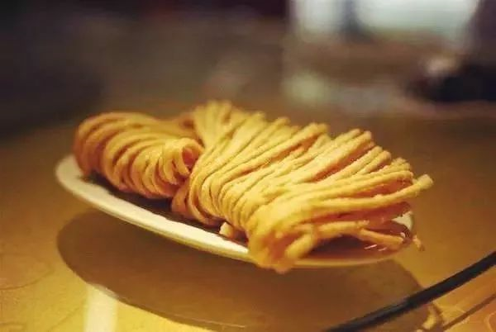
San zi 馓子

Slide 12
San zi 馓子
In both Northern and Southern China, it is a tradition to eat san zi, or fried dough twist, on Tomb Sweeping Day. The differences between san zi made by Northern and Southern people lie in sizes and materials. The former one is larger, often made from wheat and the latter is finer and made from rice.

Slide 13
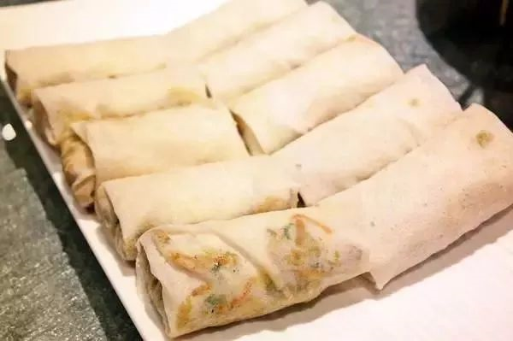
Thin pancake 薄饼

Slide 14
Thin pancake 薄饼
People in Xiamen in Fujian province often have thin pancakes on Tomb Sweeping Day. Dried seaweed, omelette, veggies and chili sauce are added in the pancakes to enhance the flavor.
福建厦门的人在清明节时常常食用薄煎饼。薄饼中加入紫菜、煎蛋、蔬菜和辣椒酱，会更加美味。

Slide 15
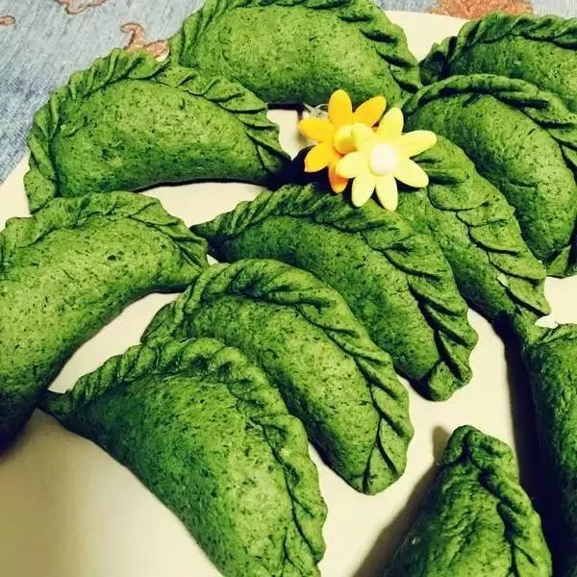
Cudweed herb rolls 清明果

Slide 16
Cudweed herb rolls 清明果
The best time to pick fresh cudweed herb is around Tomb Sweeping Day. The herb is often added in veggie rolls or dumplings and consumed on the day. In South China, people add the wild plant also in steamed buns.
清明节前后，是采摘新鲜鼠曲草（清明草）的最佳时机。当天，人们会在蔬菜卷或饺子里加入鼠曲草当作馅料。在华南地区，人们还将这种野菜加在馒头里面。

Slide 17
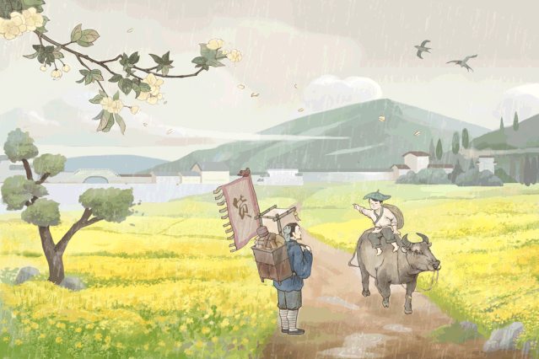
清明节相关英文词汇
Cold Food Festival 寒食节
Day of sacrifice 祭祀节日
Condolence 哀悼之情
Hell note/Joss paper 纸钱
Mourning ceremony 哀悼仪式
Offer sacrifices to ancestors 祭祖/上供
Funeral supplies/products 殡葬用品
Funeral services 殡葬服务业

Slide 18
清明节相关英文词汇
Mortician 殡仪业者
Burn incense 焚香
Tomb-sweeping 扫墓
Tomb sweeper 扫墓的人
Monument 纪念碑
Online funeral 网上葬礼
Online tribute 网上悼念
Cremation urn 骨灰盒
Inhumation 土葬

Slide 19
清明节相关英文词汇
Cremation 火葬
Sea burial 海葬
Tree burial 树葬
Celestial burial 天葬
Boat-coffin burial 船棺葬
National mourning 全国哀悼
National mourning day 全国哀悼日
Willow branches inserted on each gate 门旁插柳
Filial piety 孝顺；孝心

Slide 20
清明节相关英文词汇
Commemorate
缅怀、纪念
In memory/remembrance of
以纪念，以缅怀
In memory/remembrance of
以纪念，以缅怀
Mourn for
悼念、哀悼
Honour the memory of
缅怀

Slide 21
清明节相关英文词汇
Sweep the tomb 扫墓
burn joss paper 烧纸钱
visit the cemetery 去墓园
pay respect to remember them 追思故人
Respect your parents 孝顺父母
Honor your parents 尊敬父母，重视父母
Be big on family 重视家庭
Family guys 把家庭看的很重的人（一般指男性）
We need burn joss paper and sweep the tomb on the Tomb-sweeping Day.清明节的时候需要烧纸钱和扫墓。

Slide 22
THANK YOU

