Slide 1





春节
The Spring Festival

Slide 2

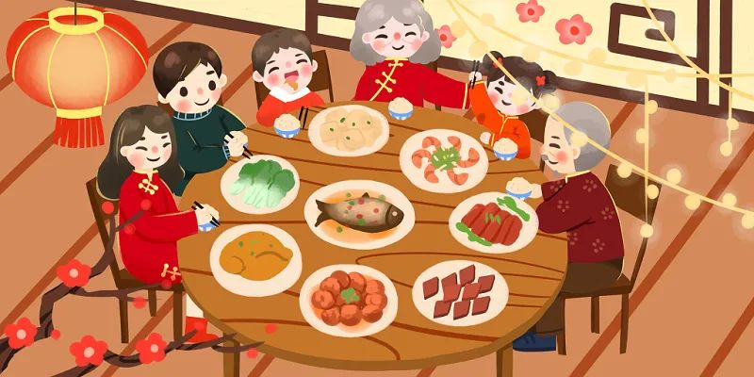
Reunion Dinner 年夜饭

Slide 3
Reunion Dinner 年夜饭
The most important tradition on New Year's Eve is having the reunion dinner. Chinese people usually attach great importance to the family. The dinner at the last day of a year is very important for them to express their love. No matter where Chinese people are, they try their best to come back home for the reunion dinner. It’s the happiest time for family members to get together to prepare and eat the dinner.

Slide 4
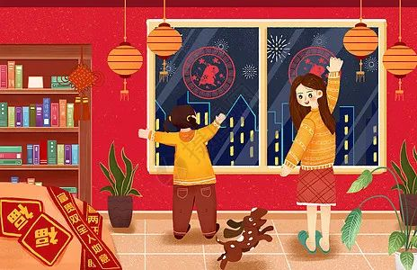
Sticking New Year's Red 贴年红

Slide 5
Sticking New Year's Red 贴年红
Sticking New Year's Red is the general name of sticking Spring Festival couplets, door gods, New Year pictures, blessings, horizontal banners, window decorations, etc. Because these are red festive elements pasted during the New Year, they are collectively called "sticking New Year's Red".

Slide 6
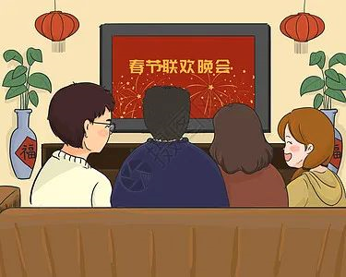
Watching Spring Festival Gala 看春晚

Slide 7
Watching Spring Festival Gala 看春晚
At 20:00 on New Year’s Eve, New Year's Evening Party Broadcast (CCTV New Year's Gala) begins on TV. Most people in China sit together to watch the broadcast. The program lasts for 4 to 5 hours accompanying the families to welcome the New Year.

Slide 8
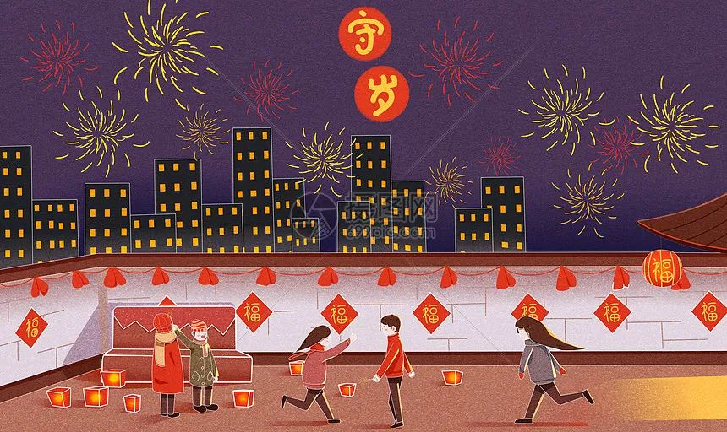
Guarding The Age (Or Year) 守岁

Slide 9
Guarding The Age (Or Year) 守岁
It is a tradition that after the rich reunion dinner on New Year's Eve, all the family members gather to stay awake all night. Staying together during the time between the years is called Shou Sui in Chinese, which means guarding the age or the year. By doing this, people think their age can be delayed to grow.

Slide 10
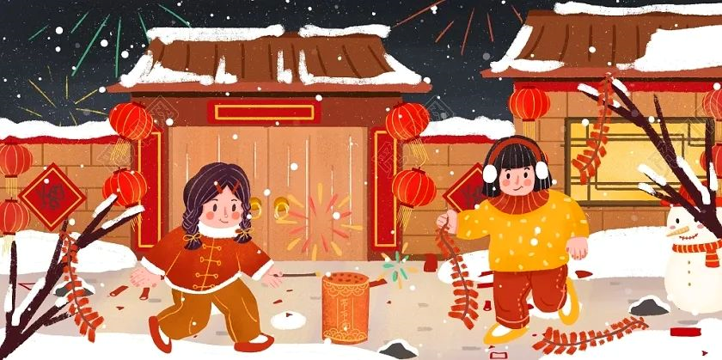
Setting Off Firecrackers And Fireworks

Slide 11
Setting Off Firecrackers And Fireworks
The tradition of setting off firecrackers and fireworks comes from the legend of Nian. Nian is a monster appearing during the Spring Festival and it fears noises. By setting off fireworks, it can be scared away. So Chinese people set off firecrackers and fireworks throughout New Year's Eve.

Slide 12
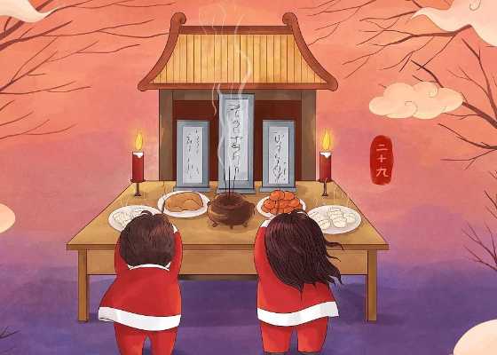
Worshipping Ancestors 祭祖

Slide 13
Worshipping Ancestors 祭祖
On New Year's Eve, people put the ancestors' photos (or paintings) and tablets in the center of the tribute table. Delicious food and wine are usually offered to the ancestors before the tablets. Family members burn sticks of incense and kowtow to them.

Slide 14
春节的英文常用词语
过年 have the Spring Festival
对联 poetic couplet: two successive rhyming lines in poetry
春联 Spring Festival couplets
剪纸 paper-cuts
年画 New Year paintings
买年货 special purchases for the Spring Festival ; do Spring Festival shopping

Slide 15
春节的英文常用词语
敬酒 propose a toast
灯笼 lantern: a portable light
灯会 exhibition of lanterns
守岁 staying-up
拜年 pay New Year's call; give New Year's greetings; New Year's visit
禁忌 taboo
去晦气 get rid of the ill- fortune
祭祖宗 offer sacrifices to one's ancestors

Slide 16
春节的英文常用词语
压岁钱 gift money; money given to children as a lunar New Year gift
辞旧岁 bid farewell to the old year
扫房 spring cleaning; general house-cleaning
八宝饭 eight treasures rice pudding
糖果盘 candy tray
什锦糖 assorted candies - sweet and fortune
蜜冬瓜 candied winter melon - growth and good health

Slide 17
春节的英文常用词语
西瓜子 red melon seed - joy, happiness, truth and sincerity
金桔 cumquat - prosperity
糖莲子 candied lotus seed - many descendents to come
糖藕 candied lotus root - fulfilling love relationship
红枣 red dates - prosperity
花生糖 peanut candy - sweet

Slide 18
春节的英文祝福语
Mom and Dad: Thank you for everything on this holiday season!
爸爸妈妈：值此佳节，感谢您们所给予的一切。
Warmest thoughts and best wishes from your daughter.
寄上无限的思念和最美好的祝愿，你们的女儿。
May you have the best season.
愿你过个最愉快的节日。

Slide 19
春节的英文祝福语
A New year greeting to cheer you from your daughter.
愿女儿的祝福带给您欢乐。
Happy New year to the world's best parents!
祝最亲爱的父母节日快乐!
Season's greetings to my dearest parents!
祝我最亲爱的父母节日愉快!

Slide 20
春节的英文祝福语
Much joy to you in the upcoming year.
愿您在新的一年充满快乐。
Thank you for your hard work and patience on this holiday season.
值此佳节，谨对您的辛勤栽培表示感谢。
May happiness follow you everywhere …just like we do.
愿快乐随时与您同在——如同我们与您寸步不离。

Slide 21
春节的英文祝福语
A New Year greeting to cheer you, my good friend.
希望新年祝福给你带来欢乐，我的好朋友。
Take your passion and make it come true.
发挥你的热情，让理想变为现实。
Best of luck in the year to come.
愿你在未来的一年里，吉星高照。

Slide 22
THANK YOU

